Slide 1
JOB DESIGN AND QUALITY OF WORK LIFE

Slide 2
OBJECTIVES
Understand the major approaches to job design.
Key to designing motivating jobs
Discuss quality of work life

Slide 3
JOB DESIGN
Specification of the content of a job
The material and equipment required to do the job
The relation of the job to other jobs.

Slide 4
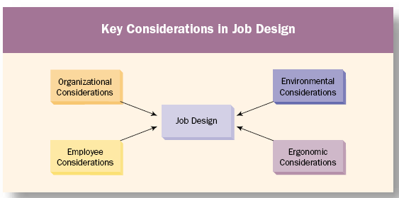
KEY CONSIDERATIONS IN JOB DESIGN

Slide 5
ERGONOMICS
    Redesign equipment to better fit the human body
    Redesign work and work processes

Slide 6
METHODS OF JOB DESIGN
Job specialisation
Job enlargement - horizontal
Job rotation
Job enrichment - vertical
Autonomous work teams

Slide 7
CONTEMPORARY METHODS OF JOB DESIGN
Compressed work week
Flexitime
Job sharing
Part - or fractional time
Telecommuting

Slide 8
SOCIO TECHNICAL SYSTEM OF JOB DESIGN
This model focuses on organizations made up of people with various competencies(social system) who use tools, machines and techniques ( technical system) to create goods and services valued by customers and other stakeholders.
The goal of this system analysis is to find the best possible match between the technology available, people involved and organizational needs.
It is high on Impact and Complexity Dimension
  Impact : Factors beyond the immediate job( Reward System, Performance Appraisal, Leadership practices, customer needs, organization structure, physical working conditions and team composition and norms.
  Complexity: the job design approach may require changes in many factors, the involvement of individuals with diverse competencies and high level of decision making competency

Slide 9
MERITS OF SOCIO-TECHNICAL SYSTEM APPROACH
Jobs designed under this approach provide greater employee job satisfaction because of fulfilling social needs of employees.
This method gives more emphasis in the participation of employees. So, the overall productivity of the organization is expected to be increased.
Employees can relate their output and social benefits. This helps to increase the tenure of employees.
Jobs create a learning environment. So, employees will be more skillful.

Slide 10
DEMERITS OF SOCIO-TECHNICAL SYSTEM APPROACH
Jobs give more emphasis on employee needs rather than on organizational needs.
Most of the operating level employees may not be efficient for the decision making. So, the decision made by employees may sometimes mislead the organizational objectives.
Employee union for sake of union-only may influence the overall planning of the organization.

Slide 11
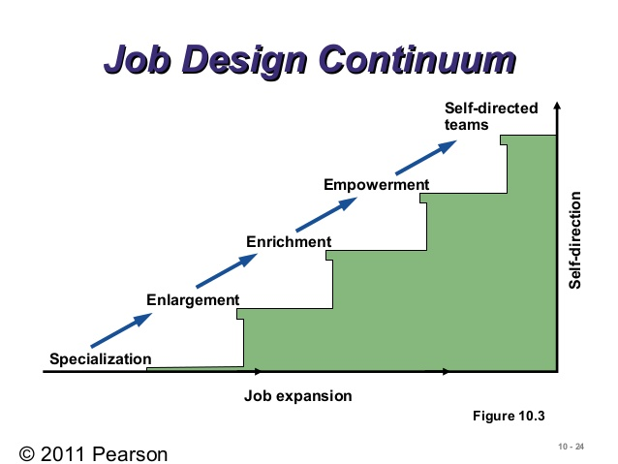
JOB DESIGN CONTINUUM

Slide 12
A) JOB SPECIALIZATION
  Using standardized work procedures
  Employees perform repetitive, precisely defined task
  Usually used by industrial engineers and analysts
  Adv:
    Improve operating efficiencies through use of low-skill and low cost labour
    Minimum on-job-training
    Easy control of production quantities
    Fewer errors
  Disadv:
    Boredom and lack of challenge
    Employees are restricted by the speed of assembly line
    No end product
    Limited social interaction
    Employees have no decision making involvement

Slide 13
JOB ENLARGEMENT
  Horizontal expansion of a job by adding similar level responsibilities
  By adding multiple skilling, task varieties or increasing work interests

Slide 14
Job Rotation
  Increase task variety by moving employees from one task to another function/geography
  Typical in Japanese company
  Adv: higher satisfaction, develop general perspective, increase skills
  Disadv: increase training costs, lower productivity, disruption, lower specialty

Slide 15
JOB ENRICHMENT
  Vertical expansion of a job by adding planning and decision making responsibilities
  Employees may have greater achievement, recognition, responsibility and personal growth and motivation
  By combing tasks, establishing client relationships, expanding jobs vertically (increase employees’ autonomy and control ability), and opening feedback channels

Slide 16
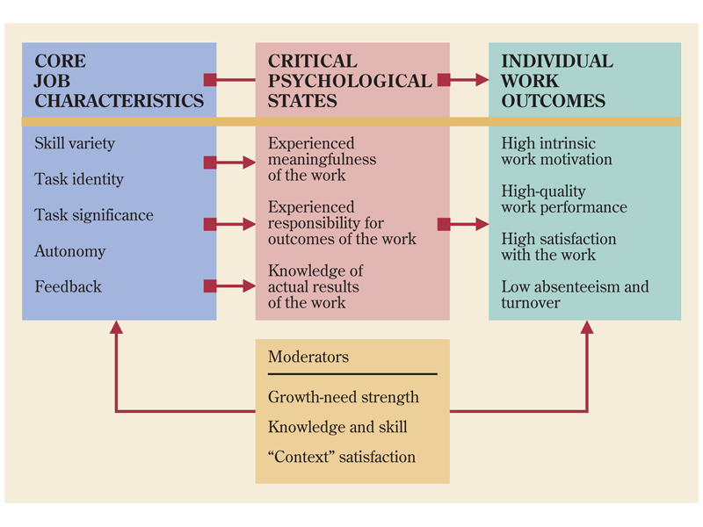
JOB CHARACTERISTICS ENRICHMENT MODEL (HACKMAN- OLDHAM)

Slide 17
WHAT ARE THE KEYS TO DESIGNING MOTIVATING JOBS?
Core job characteristics
  Skill variety
    Degree to which a job requires a variety of different activities and involves the use of a number of different skills and talents of the individual
  Task identity
    Degree to which the job requires the completion of a “whole” and identifiable piece of work; one that involves doing a job from beginning to end with a visible outcome

Slide 18
WHAT ARE THE KEYS TO DESIGNING MOTIVATING JOBS?
Core job characteristics (cont.)
  Task significance
    Degree to which the job is important and involves a meaningful contribution to the organization or society in general
  Autonomy
    Degree to which the job gives the employee substantial freedom, independence, and discretion in scheduling the work and in determining the procedures used in carrying it out

Slide 19
WHAT ARE THE KEYS TO DESIGNING MOTIVATING JOBS?
Core job characteristics (cont.)
  Job feedback
    Degree to which carrying out the work activities provides direct and clear information to the employee regarding how well the job has been done

Slide 20
WHAT ARE THE KEYS TO DESIGNING MOTIVATING JOBS?
Critical psychological states
  When the core characteristics are highly enriched, three critical psychological states are positively influenced
    Experienced meaningfulness of work
    Experienced responsibility for work outcomes
    Knowledge of actual results of work activities

Slide 21
WHAT ARE THE KEYS TO DESIGNING MOTIVATING JOBS?
Enriched core job characteristics will create positive psychological states, which in turn will create positive work outcomes only when:
  Employee growth-need strength is high.
  The employee has the requisite knowledge and skill.
  Employee context satisfaction exists.

Slide 22
WHAT ARE THE KEYS TO DESIGNING MOTIVATING JOBS?
Motivating potential score
  MPS indicates the degree to which the job is capable of motivating people.
  A job’s MPS can be raised by enriching the core characteristics.

Slide 23
FIVE CORE JOB CHARACTERISTICS-KAYLEE
Motivating Potential Score
Skill
variety
Task
identity
Task
significance
+
+
MPS =
x [Autonomy] x [Feedback]
3

Slide 24
QUALITY OF WORK LIFE
Adequate remuneration
Development of human capabilities
Growth and security
Constitutionalism
Total life space
Social relevance

Slide 25
REFERENCES
S. Robbins, Organizational Behavior, 11th Ed, Prentice-Hall Inc, 2005
http://home.chuhai.hk/~charmaine/Human%20Resource%20Management/Lecture%2003/Chapter%205/chapter%205.PDF
https://assignmentpoint.com/socio-technical-approach-of-job-design/

